Slide 1

Interview is a Conversation

Slide 2

What is the goal of asking questions in an interview?

Slide 3

Get the information you need to decide on an offer

Slide 4

When your interview is over, you should know:
The job you will be doing
Technologies you will be using
What is expected of you
What is the growth potential
The team/work environment

Slide 5

Show Your Interest in the Position
Notes:
You do it with your friends: tell me more, tell me more

Slide 6

Ask questions during the interview:
After you have answered their question (2-3 times in a 30 min interview).
MUST relate to what the interviewer asked you
Notes:
GIVE EXAMPLES

Slide 7

MUST ask questions at the end of the interview:
Ask 2-3 questions important for your happiness at work:
Company
Culture
Future team
Onboarding/training
Anything you forgot to ask

Slide 8
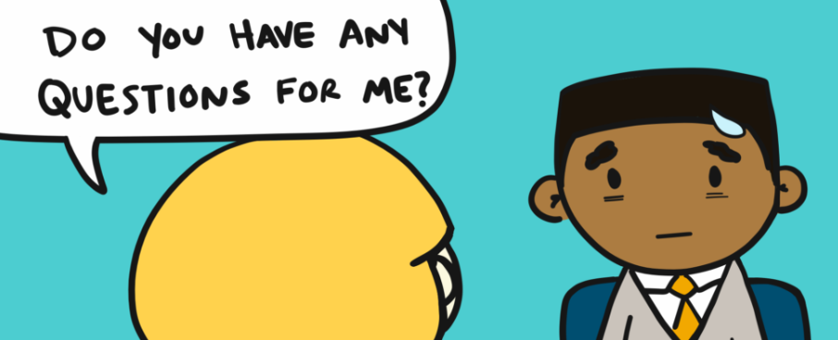
Know your audience - what you ask will depend on who your interview is:
HR
Technical
Hiring Manager
CEO,CTO
Notes:
Have 10 questions prepared

Slide 9

End with “That’s all of the questions I have right now”
The interviewer will start closing the interview…

Slide 10
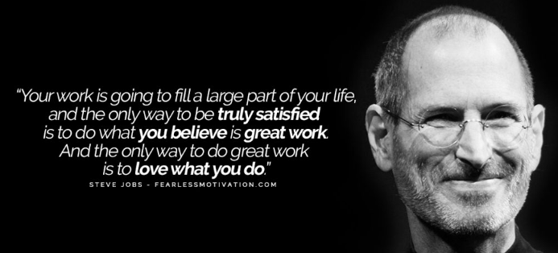
Consequences of not asking questions
Unhappy in job
Not a good fit with the team/remote team
Overwhelmed/bored
Don’t like the technologies
Feel unsupported
Not Selected!

Slide 11
Prepare!!
Interviewing Is A Two-Way Street:
you need to be comfortable in answering the questions asked
You need to be prepared to ask questions (write down 7-10 questions in preparation for the interview)
Notes:
10 questions Not good: if it is on JD, if it is easily found on their webpage if it’s common knowledge – easily available on the internet, personal questions.

Slide 12
Put this into practice:
Now, add follow up questions after STARs in your workbook
Next, we will use these to practice answering STAR questions and asking a thoughtful follow up question right after

